Slide 1


WELCOME TO
MY PRESENTION

Slide 2

PRESENTATION
On
Weather Web

Slide 3

ABSTRACT
Weather forecasting is the prediction of the state and city of the atmosphere for a given location using the application of science and technology. This includes temperature, rain, cloudiness, wins speed, and humidity. Weather warning are a special kind of short-range forecast carried out for the protection of human life.

Slide 4
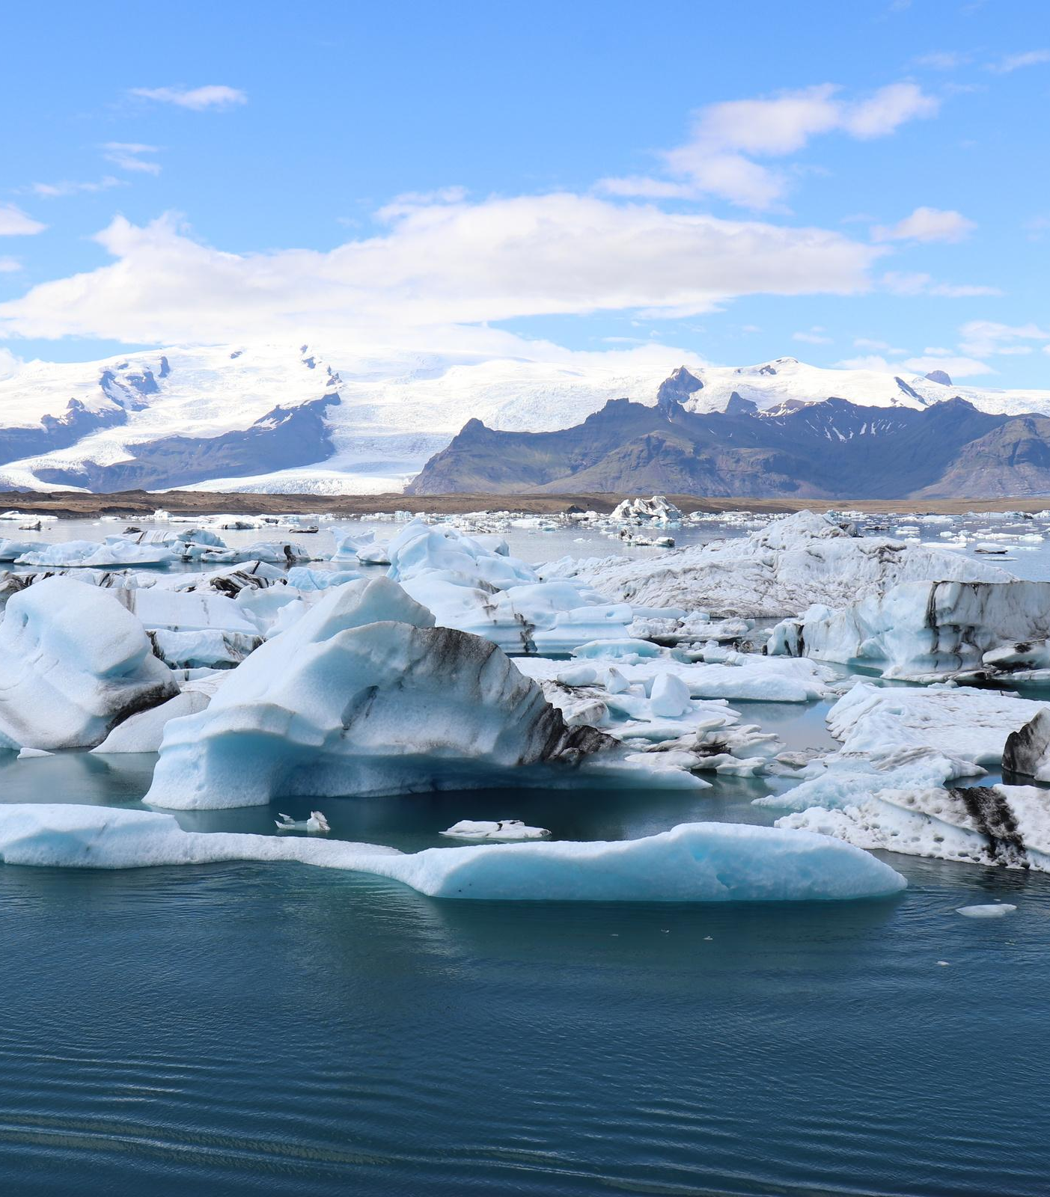


Table of Contents
Introduction
Software Requirements
Hardware Requirements
Goals of Proposed System
Weather Web Contains
Various Operation
Module for Weather Web
Advantages
Screen Shorts
Conclusion

Slide 5



This a weather application of science and technology to predict the conditions of the atmosphere for a given location and time with help of Rest Api’s.

Slide 6

"
Software Requirements
"
Operation System: Above fro window Xp.
Web Development Platform: ASP, .NET 4.0
Back-end: MongoDB and MongoDB Compass.
Browser: Microsoft Edge, Chrome and Mozilla Firefox

Slide 7
Hardware Requirements
Intel pentium or and processors with speed minimum (2.10Ghz) .
Minimum 1GB RAM.
Accelerated graphics card.
Minimum 50MB hard disk.
Better performance with 2.10Ghz and Above each memory

Slide 8



Proposed System
Planned approach towards working:- | The working in the organization will planned and organized. The data will be stored properly in data well as its storage.
Accuracy:- | The level of accuracy in the proposed system will be higher. all operation would be done correctly and it ensure that whatever information is coming from the center is accurate.
Reliability:- | The reliability of the proposed system will be high due to the above stated reasons. The reason for the increased reliability of the system is that now there would be proper storage of information.
Easy To Operate:- | The system should be easy to operate and should be such that it can be developed within a short period of time and fit in the limited budget of the user.

Slide 9
Weather Web Contains
Homepage
User Sign in
User Sign Up
Add Location
Search Weather

Slide 10

Various Operational Works That are Done In The System Are
Recording Information of the User.
Checking information filled by voter.
Discard the false information
Each information send to the database

Slide 11


Module For Weather Web
Login/sign up
Search State
Search City
Add Location
Search Weather

Slide 12


Advantages
This app will help anyone to choose where and when to take their holidays to take advantages of good weather. Surfers known when large wave are expected

Slide 13

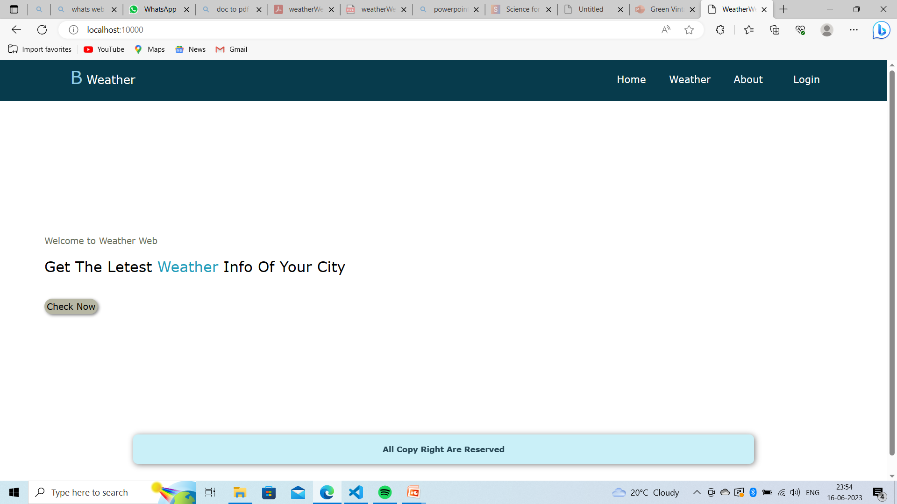
Screen Shots

Slide 14

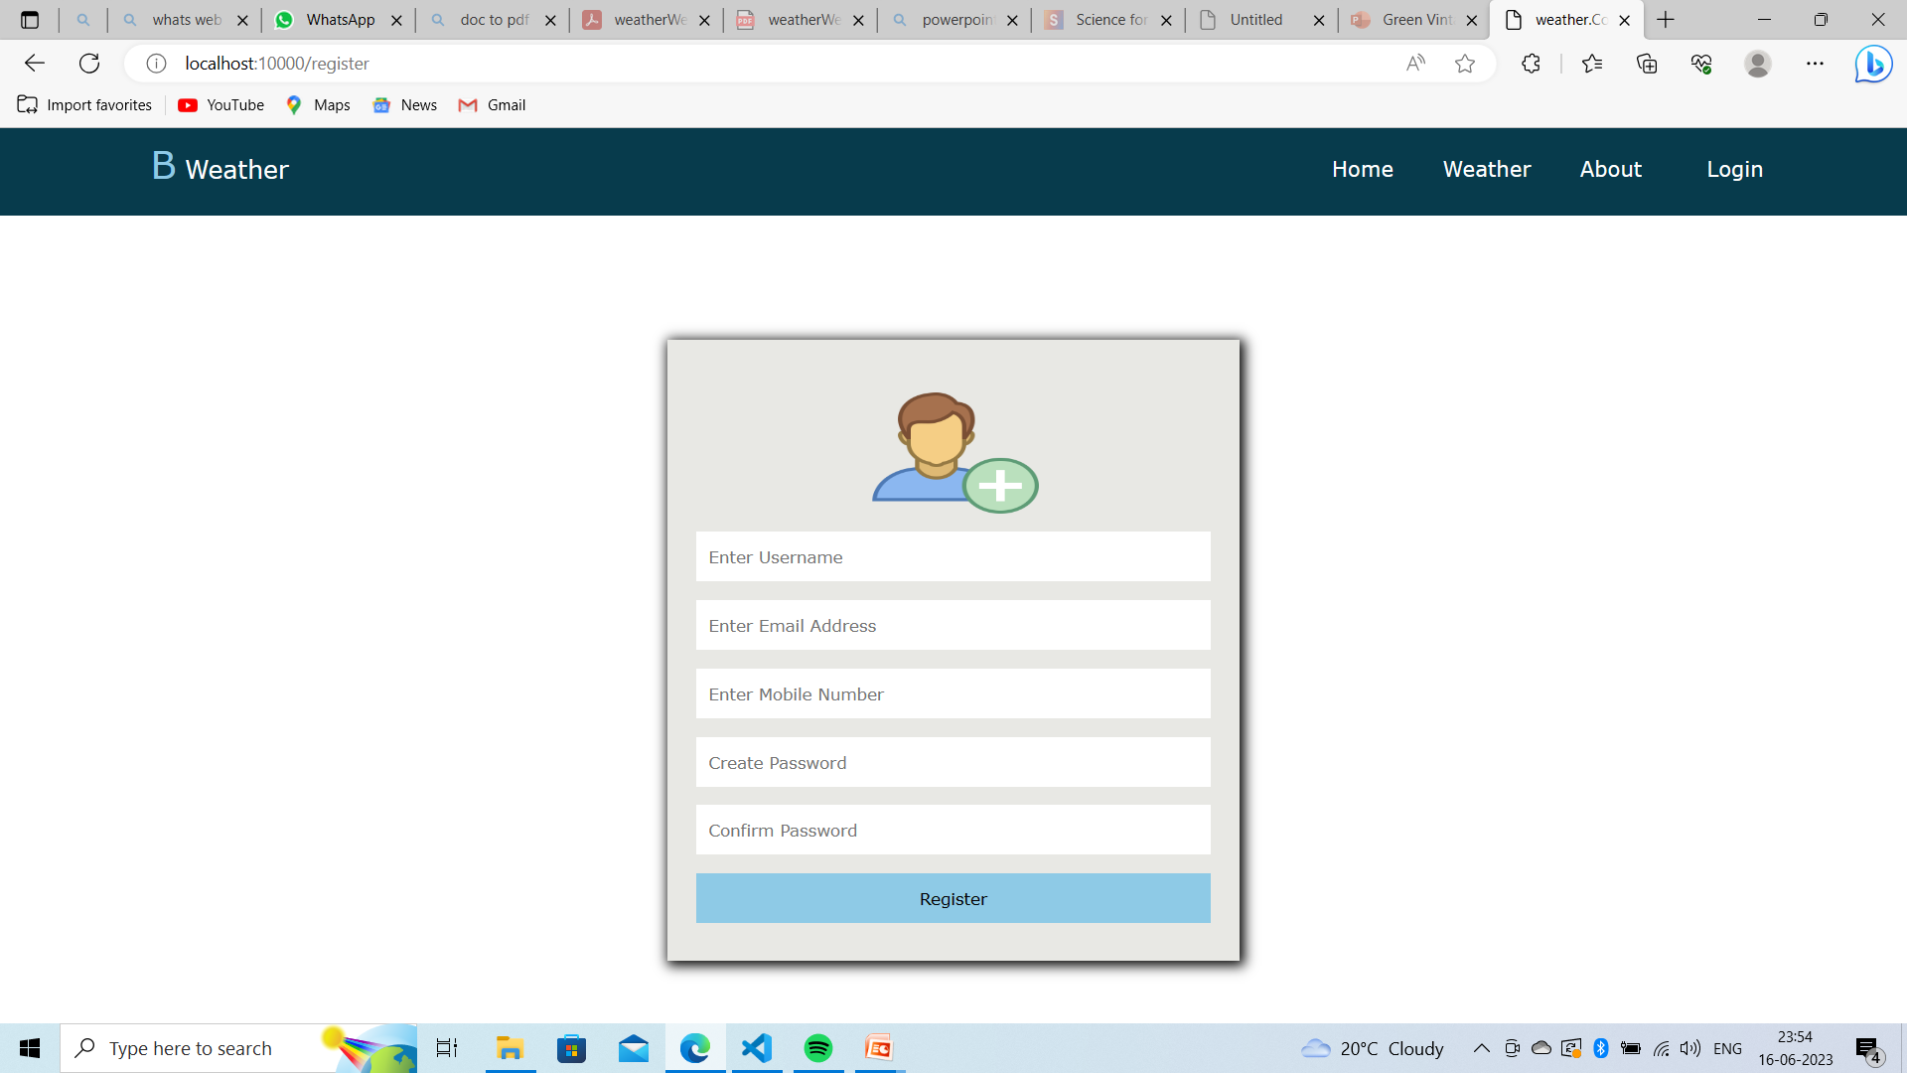
Screen Shots

Slide 15

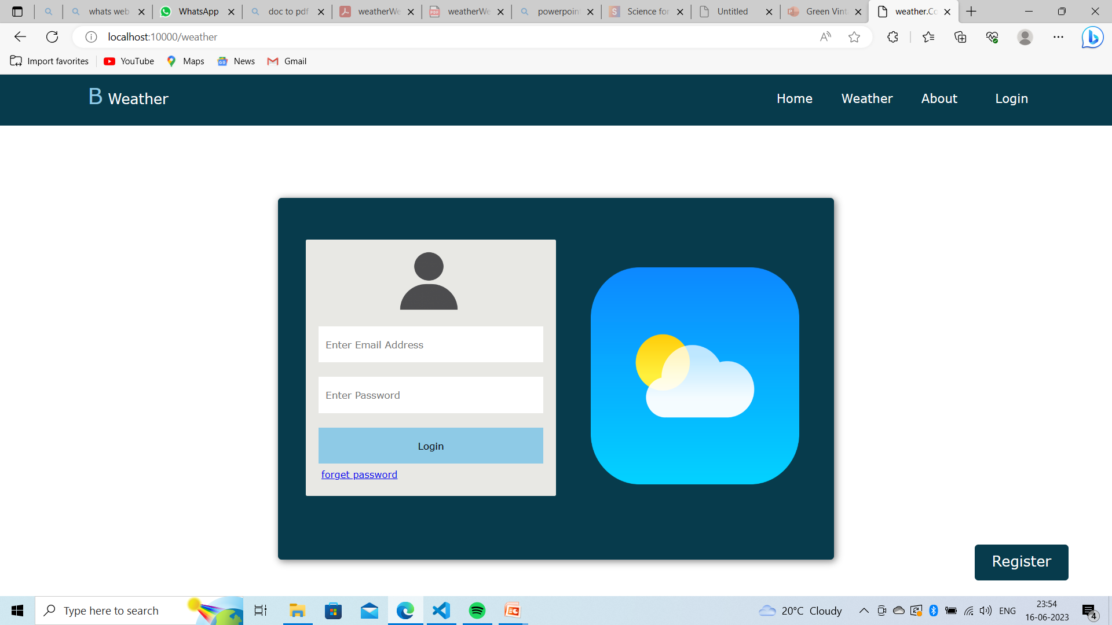
Screen Shots

Slide 16
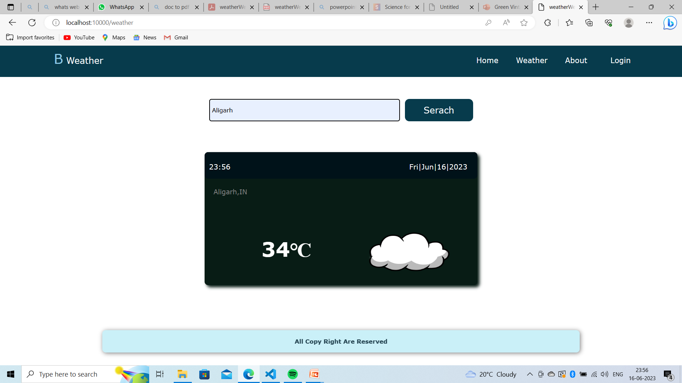
Screen Shots

Slide 17

Conclusion
Simply know what weather bring just from the comfort of you handy smart mobile device, PCs and tablets. The App also pressure modules track details of you favorite cities and regions. And even more…. All with the weather Web.

Slide 18
References
www.wikipedia.com
www.w3school.com
www.google.com
www.stackoverflow.com

Slide 19


Thank
you

